Slide 1

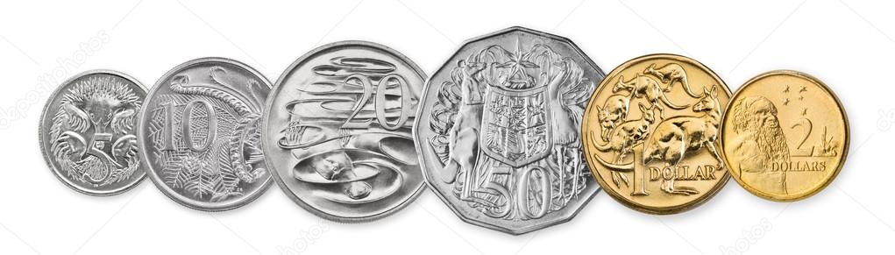

My Probability Interactive Notebook
Name
Class
Teacher
Term 4 Semester 2
1

Slide 2
Warm Up Dice Bingo
Draw a 3 x 3 table.
Two dice will be rolled. The uppermost faces then added together. Write the totals you think will come up.
You may use the same number more than once, but can only cross one number each go.

Slide 3
Contents
Glossary or Formula Page
Page
Date
Description
2
3

Slide 4
Tasks
24
7
30
Essential Question
Questions
Notes
Summary
4
5

Slide 5

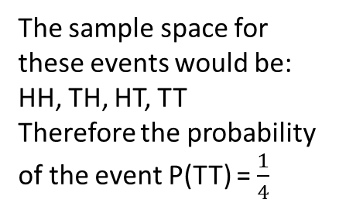
24
7
30
Date
Tables
EQ – How can I list the outcomes for multiple experiments?
Insert Question Here
When there is two probability experiments, we can use a table to represent all the possible__________.
For example;
If we toss two coins, what is the probability of getting tails on both coins?
One experiment goes across the horizontal and the other goes down the vertical
The sample space for these events would be:
HH, TH, HT, TT
Therefore the probability of the event P(TT) = $\frac{1}{4}$
Write the outcomes in the table
 |  | 1st Coin
 |  | H | T
2nd Coin | H
 | T
What about the probability of getting one of each?
HH
TH
HT
TT
P(HT, TH) = $\frac{2}{4}$
7

Slide 6
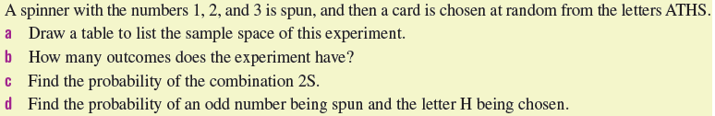
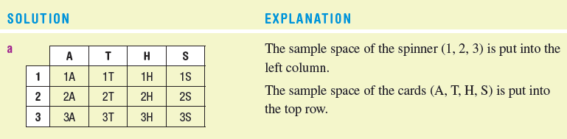
Let’s try this together

Slide 7

Do you understand?
Notes:
Check for Understanding

Slide 8

Your Turn
Turn to page 250 in the Dwyer Book and complete Exercise 18.5
Left Hand Side

Slide 9
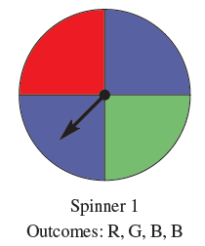
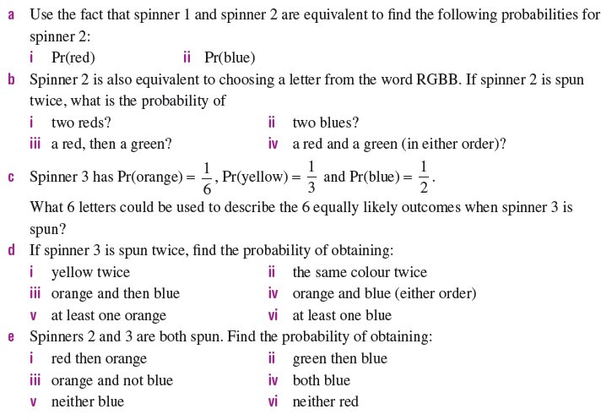
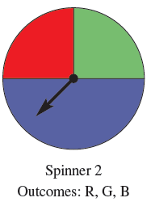
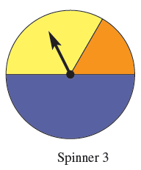
Challenge for fast finishers

